Slide 1
levi9 CODE9 2021
Azure SQL database
Ružica Kresoja
Novi Sad, 24.05.2021

Slide 2
Agenda Slide
01
03
About Me
Demonstration in Azure
02
04
SQL DB intro
Questions and end slides

Slide 3
01. About me
Ružica Kresoja
- .Net software developer
- More than 10 years experience, 5 years in IT industry

Slide 4
01 SQL Database intro
Relation database management system (RDMBS)
-T-SQL (DDL, DML)
SQL Server Architecture
- Database Engine (Storage Engine, Relational Engine)
- SQLOS
SQL Server Services and Tools
SSIS (SQL Server Data Quality Services) (example: for loading csv data into databse)
SSRS (SQL Server Reporting Service)
SSMS (SQL Server Mangement Studio)
Etc...

Slide 5
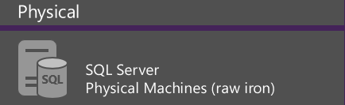
Microsoft SQL Platform Continuum
Hybrid Cloud
Shared Lower Cost
On Premises
Platform as a Service
SQL
SQL
SQL
Azure SQL Database Virtualized Databases
Infrastructure as a Service
SQL
SQL
SQL
SQL Server in Azure VM Virtualized Machines
Virtual
SQL
SQL
SQL
SQL Server Private Cloud Virtualized Machines + Appliances
Dedicated Higher Cost
Off Premises
Higher Administration
Lower Administration

Slide 6
Azure SQL Database
Relational database-as-a-service, fully managed by Microsoft
For cloud-designed apps when enterprise-grade features and near-zero administration are key
Elastic Scale and Performance
Business Continuity and Data Protection
Self-managed and Familiar
Predictable performance levels
Scale up/down & out/in
Dashboard views of DB metrics
Self-service restore
Disaster recovery
Compliance-enabled
Self-managed
Programmatic APIs
Familiar tools and language
Enterprise-grade database platform with cloud economics

Slide 7
Advantages of Using Azure SQL Databases
Usability
Scalability
Accessibility
Data-Loss Prevention
High Speed and minimal Down Time
Improved Usability
Easy-to-Use Migration Tools
Multiple user access 24 hours a day 365 days a year
Lower development costs
…

Slide 8
Azure SQL Database Service Tiers
Basic
Standard
Premium
Basic
Intended Use
Light transactional loads
Go-to option for most business applications
High throughput and business-critical databases
Availability
99.99%*
Size
2 GB
250 GB
500 GB
Performance
•
••
•••
Business Continuity
•
••
•••
Incremental performance and features with easy upgrade and downgrade

Slide 9
02 Demonstration in AZURE
Staring from requirement:
Survey have time frame for which is open. After time expires survey is automatically closed or user which created can do that before time expires
Survey contains questions and offered answers
Participant needs to fill in next mandatory parameters before log into application: FirstName, LastName, Email and Password
- Creator of survey should have possibility to follow answers on front end

Slide 10
Database model - recommendations
Naming convention for creating database object should exist
- Tables names must end with s
PimaryKeys: PK_<TableName>
Foreign Keys: FK_<TableName>_<TableName2>
Unique Indexes/Constraints: UN_<TableName>_<Columns>
Use schemas for grouping database objects
Use foreign key constraints to protect your data from garbage
Add auto-increment identity in most cases. Only on static table in not needed.
In every table add columns for information who created, updated row and dates for actions.
Build tables to suport milion of rows.
Decuple tables entries if it is possible

Slide 11
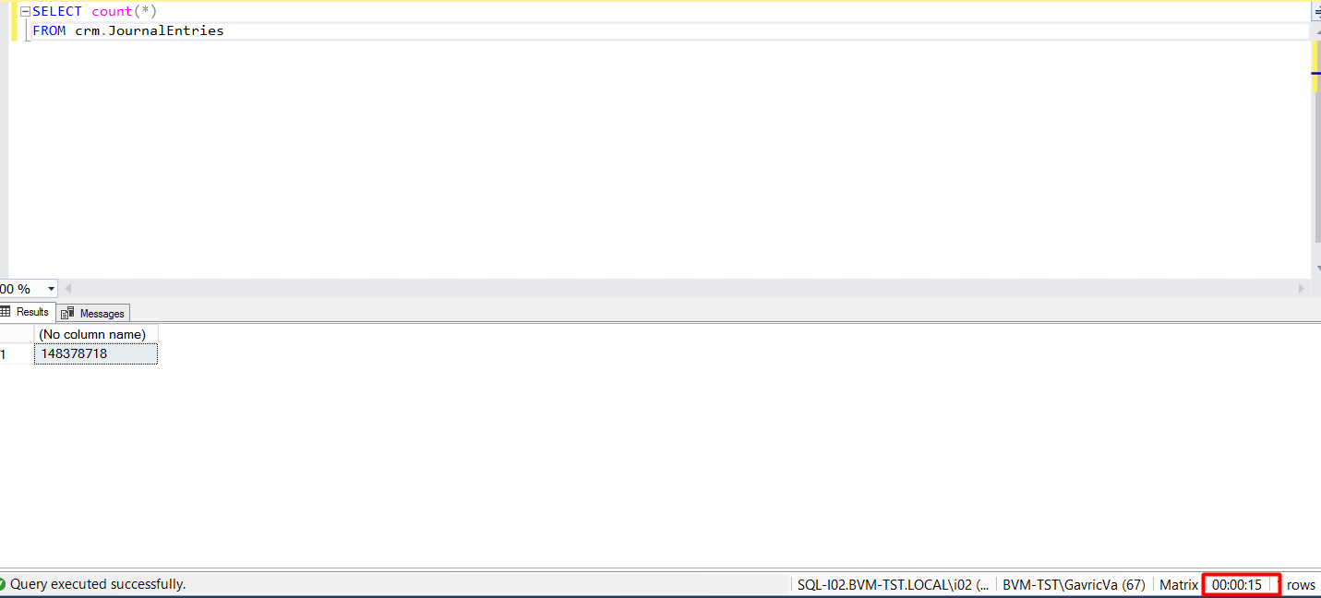
Examples of bad data models
Bank system have customers which have data (First Name, Last Name, JMBG etc...)
Every customer have accounts and payments
We are determining name journal for every change on customer data or on payment
As result we have next:
15 seconds only for counts
For solving, indexes should be added
Use SOLID principles and patterns
Database should be only used for tables

Slide 12
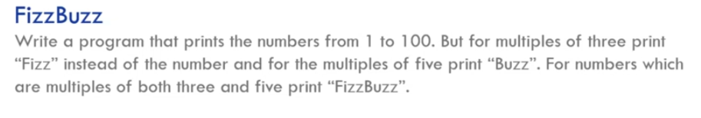
Think about
How this can be implemented without iterator and switch case statements?

Slide 13
Questions

Slide 14
Thank you
Serbia / Novi sad
Levi9 Global Sourcing Balkan d.o.o.
Novi Sad Offices
Trifkovicev trg 6
21000 Novi Sad, Serbia

